Slide 2
Bible Places in the Aegean
Athens
Ephesus
Corinth

Slide 3
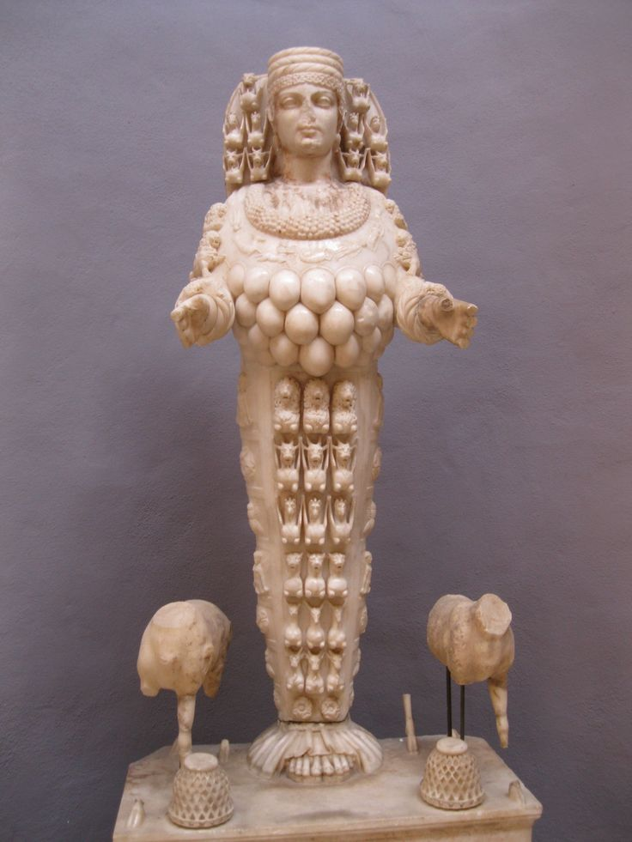
Artemis of the Ephesians

Slide 4
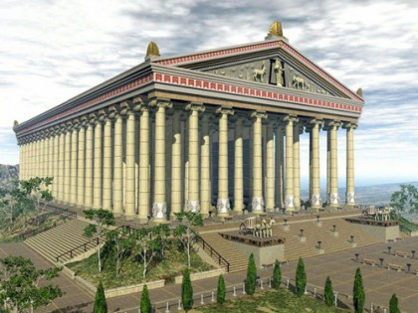
The Temple of Artemis

Slide 5
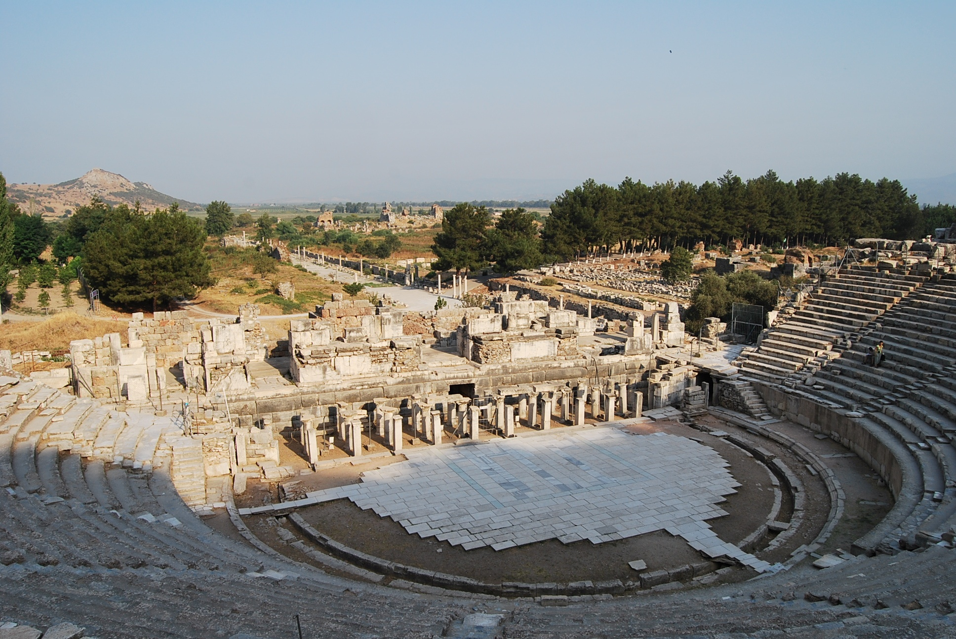
The Theatre at Ephesus

